Slide 1
DAYANANDA SAGAR COLLEGE OF ENGINEERING
Shavige Malleshwara Hills, Kumaraswamy Layout, Bengaluru 560111
DEPARTMENT OF MEDICAL ELECTRONICS ENGINEERNG
Internship Presentation – VIII Semester
20/05/2025
ADWIN JUSTA MANUEL | 1DS21MD004
Internal Guide – Dr. Padma C R., Associate Professor
Mentor – Dr. N . Sriraam., Dean R&D, Professor and HOD, Department of Medical Electronics Engineering
Internal Mentor – Kiran D ,JRF.

Slide 2
Vision and Mission
VISION OF INSTITUTE
To impart quality technical education with a focus on research and innovation, emphasizing on development of sustainable and inclusive technology for the benefit of society
MISSION OF INSTITUTE
To provide an environment that enhances creativity and innovation in pursuit of excellence
To nurture teamwork in order to transform individuals as responsible leaders and entrepreneurs
To train the students to the changing technical scenario and make them to understand the importance of sustainable and inclusive technologies
VISION OF DEPARTMENT
To develop an excellent centre of progressive quality learning, applied & translational research through inventive collaborations and sustainable solutions to address healthcare related societal challenges
MISSION OF DEPARTMENT
By creating a conducive atmosphere for continuous learning through increased participation of students and faculty in various academic activities
By achieving needful and relevant healthcare solutions through quality education and research
By imparting education in the path of ethical and social responsibilities, to work effectively with diverse groups for the benefit of the society

Slide 3
Program Outcomes (POs)
Engineering Graduates will be able to:
Engineering Knowledge: Apply the Knowledge of Mathematics, Science, Engineering Fundamentals, and an Engineering specialization to the solution of complex Engineering problems
Problem Analysis: Identify, Formulate, Review research literature, and analyze complex engineering problems reaching substantiated conclusions using first principles of Mathematics, natural sciences and engineering sciences
Design/Development of solutions: Design solutions for complex engineering problems and design system components or processes that meet the specified needs with appropriate consideration for the public health and safety, and the cultural, societal, and environmental conditions
Conduct investigations on complex problems: Use research based knowledge and research methods including design of Experiments, analysis and interpretation of data, and synthesis of Information to provide valid conclusions
Modern tool usage: Create, select, and apply appropriate technique, resources, and modern engineering and IT tools including prediction and modelling to complex engineering activities with an understanding of the limitations
The Engineer and the world: Apply reasoning informed by the contextual knowledge to assess society, health, safety, legal and cultural issues and the consequent responsibilities relevant to the professional engineering practice
Ethics: Apply ethical principles and commit to professional ethics and responsibilities and norms of the engineering practice
Individual and team work: Function effectively as an individual, and as a member or leader in diverse teams, and in multidisciplinary settings
Communication: Communicate effectively on complex engineering activities with the engineering community and with society at large, such as, being able to comprehend and write effective reports and design documentation, make effective presentations, and give and receive clear instructions
Project management and finance: Demonstrate knowledge and understanding of the engineering and management principles and apply these to one’s work, as a member and leader in a team, to manage projects and in multidisciplinary environments
Lifelong learning: Recognize the need for, and have the preparation and ability to engage in independent and life-long learning in the broadest context of technological change

Slide 4
Program Educational Objectives (PEOs) and Program Specific Outcomes (PSOs)

Slide 5
“DESIGN AND DEVELOPMENT OF WIRELESS FLEXIBLE ELECTRONICS NASAL WIFLEN MASK FOR RESPIRATORY BREATHING ASSESSMENTS”

Slide 6
CONTENTS
Brief about the organization
Existing technology/ instruments
Introduction
Implemented / Studied as a part of the Internship
References
DEPARTMENT OF MEDICAL ELECTRONICS ENGINEERING, DAYANANDA SAGAR COLLEGE OF ENGINEERING

Slide 7

ABOUT ORGANIZATION
Dayananda Sagar College of Engineering (DSCE) is a prestigious private engineering institution in Bangalore, India. Established in 1979 under the Mahatma Gandhi Vidya Peetha Trust. The college is affiliated with Visvesvaraya Technological University (VTU) and accredited by NBA and NAAC (A grade).
DSCE fosters a dynamic organizational structure with:
Governing Council & Academic Leadership: Led by experienced academicians and industry experts.
Departments & Research Centers: Dedicated faculty and state-of-the-art labs supporting research and learning.
Student Development & Industry Collaboration: Active student clubs, corporate partnerships, and placement cells ensure holistic growth.
1

Slide 8
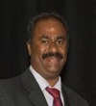
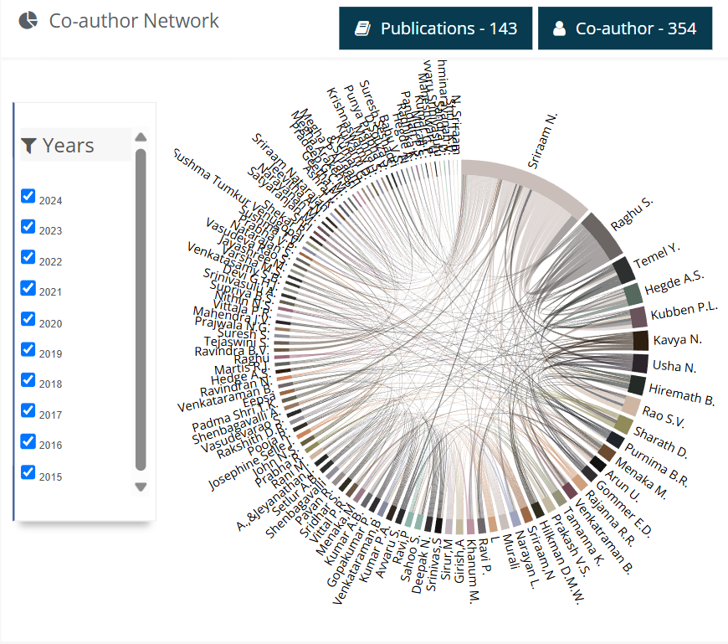
MENTOR
Dr. N. Sriraam has been an exceptional mentor for my internship on "Design and Development of Wireless Flexible Electronics Nasal Wiflen Mask for Respiratory Breathing Assessments." As Dean ,R&D and Professor in Medical Electronics Engineering, his expertise in wearable electronics and biomedical signal processing greatly enriched my research experience. With 26 years of research experience, he has made significant contributions through over 158 international journal publications, 146 conference papers, and multiple patents. His Vidwan profile score is 9.2 (https://vidwan.inflibnet.ac.in/profile/194352), reflecting his strong research impact.
DR. N. SRIRAAM
Dean R&D, Professor and HOD, Department of Medical Electronics Engineering
Fig2:Co-author Network of Mentor((https://vidwan.inflibnet.ac.in/profile/194352)
2

Slide 9
Existing technology/ instruments
1. Respiratory Inductance Plethysmography (RIP)
Working Principle: Uses elastic belts with embedded inductive coils placed around the chest and abdomen to detect expansion and contraction during breathing.
Use Case: Sleep studies (e.g., diagnosing sleep apnea), hospital monitoring.
Pros: Accurate measurement of tidal volume and breathing effort.
Cons: Requires proper placement; can be intrusive for long-term wear.
3

Slide 10
2. Capnography
Working Principle: Measures the concentration of CO₂ in exhaled air using a nasal cannula or mouthpiece.
Sensor Type: Infrared spectroscopy (NDIR).
Use Case: Emergency medicine, anesthesia, and ICU.
Pros: Provides real-time respiration rate and quality.
Cons: Requires a connected nasal tube or cannula; not wearable-friendly.
3. Acoustic Sensors (Microphone-based)
Working Principle: Detect breathing sounds and patterns using microphones placed near the nose, throat, or chest.
Use Case: Sleep monitoring, fitness devices, telemedicine.
Pros: Can be contactless or minimally invasive.
Cons: Susceptible to noise; limited detail on volume or gas composition.
4. Radar and RF-based Sensors
Working Principle: Use ultra-wideband (UWB) radar or Doppler radar to detect chest movement through changes in reflected radio waves.
Use Case: Contactless patient monitoring, smart homes, automotive health systems.
Pros: Completely non-contact; works through clothes and bedding.
Cons: Expensive; may be affected by other motion in the environment.
4

Slide 11
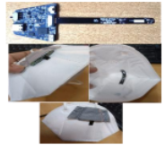
INTRODUCTION
“DESIGN AND DEVELOPMENT OF WIRELESS FLEXIBLE ELECTRONICS NASAL WIFLEN MASK FOR RESPIRATORY BREATHING ASSESSMENTS”
The Design and Development of Wireless Flexible Electronics Nasal Wiflen Mask for Respiratory Breathing Assessments is an innovative project aimed at developing a wearable, non-invasive respiratory monitoring system. This flexible electronics-based nasal mask integrates wireless sensor technology to continuously track and assess breathing patterns, aiding in early diagnosis and management of respiratory conditions.
Key Features:
Flexible Electronics Integration: Ensures comfort and adaptability for long-term use.
Wireless Connectivity: Enables real-time data transmission for remote monitoring.
Respiratory Signal Analysis: Provides accurate assessments of airflow, rate, and irregularities.
AI-Based Processing: Supports predictive analysis for respiratory health conditions.
Fig3 : TRL-4 Stage Prototype
5

Slide 12
TASK DETAILS AS A PART OF THE INTERNSHIP
Task 1 – Literature Review
Task 3 – Search open source data related to Respiration signals
Task 2 – Learn Python and its libraries required for Deep Learning .
Task 4 – Build a python module for processing of signals from open source data and train and validate for different models.
6

Slide 13



TECHNICAL SKILLS ACQUIRED AS PART OF THE INTERNSHIP
TECHNICAL SKILLS ACQUIRED
7

Slide 14
LEARNING OUTCOMES AS PART OF THE INTERNSHIP
Developed and trained deep learning models (e.g., CNN, LSTM) to analyze and classify breathing patterns from real-time sensor data.
Preprocessed multi-modal physiological data including pressure, temperature, and humidity signals for feature extraction and model input.
Implemented signal processing algorithms to remove noise and artifacts from breathing signals for accurate pattern recognition.
Utilized machine learning frameworks such as TensorFlow and PyTorch to build and evaluate AI models for respiratory condition detection (e.g., apnea, shallow breathing).
Optimized model performance through hyperparameter tuning and cross-validation for deployment in edge devices.
8

Slide 15
ACTIVITY LOG AS PART OF THE INTERNSHIP
Week 1-2 (Jan 27 – Feb 9)
Orientation and introduction to the project objectives and tools.
Studied nasal airflow dynamics and wearable sensor technologies.
Researched existing breathing assessment methods and AI applications.
Familiarized with Python, sensor APIs, and biomedical signal formats.
Week 3-4 (Feb 10 – Feb 23)
Assisted in the initial design of the flexible nasal WIFLEN mask.
Integrated basic sensors (pressure, temperature, humidity) with microcontrollers.
Set up real-time data acquisition using wireless modules (e.g., BLE/Wi-Fi).
Explored datasets and defined data collection protocols.
Week 5-6 (Feb 24 – Mar 8)
Collected raw respiratory data from test subjects using the mask.
Preprocessed sensor data: filtering, normalization, and segmentation.
Started exploratory data analysis to identify breathing pattern markers.
Began developing initial machine learning models (SVM, Random Forest).
9

Slide 16
Week 7-8 (Mar 9 – Mar 22)
Transitioned to deep learning models (CNN, LSTM) for time-series classification.
Labeled data for supervised training (normal vs abnormal breathing).
Trained and evaluated models using k-fold cross-validation.
Compared model performance metrics (accuracy, precision, recall).
Week 9-10 (Mar 23 – Apr 5)
Optimized deep learning architectures and hyperparameters.
Implemented real-time inference for breathing pattern classification.
Worked on integrating AI model output into the mask’s interface.
Documented results and AI model architecture.
Week 11-12 (Apr 6 – Apr 19)
Conducted multi-subject validation and robustness testing.
Tuned wireless system for stable data transmission.
Assisted in PCB design for the flexible electronics module.
Collaborated with biomedical mentors to interpret clinical implications.
10

Slide 17
Week 13-14 (Apr 20 – May 3)
Finalized AI model deployment on embedded system.
Conducted usability testing and gathered feedback for improvements.
Prepared presentation and demonstration of the complete system.
Wrote report sections on AI model development and results.
Week 15 (May 4 – May 12)
Final review and documentation of internship work.
Submitted final project report and code repositories.
Delivered presentation to faculty and industry mentors.
Reflected on learning outcomes and received feedback.
11

Slide 18
Ensemble Model Frame Work
INPUT
Feature Extraction
Temporal Learning
CNN
LSTM
TRANSFORMER ENCODER
CUSTOM ATTENTION LAYER
DENSE LAYER
OUTPUT
12

Slide 19
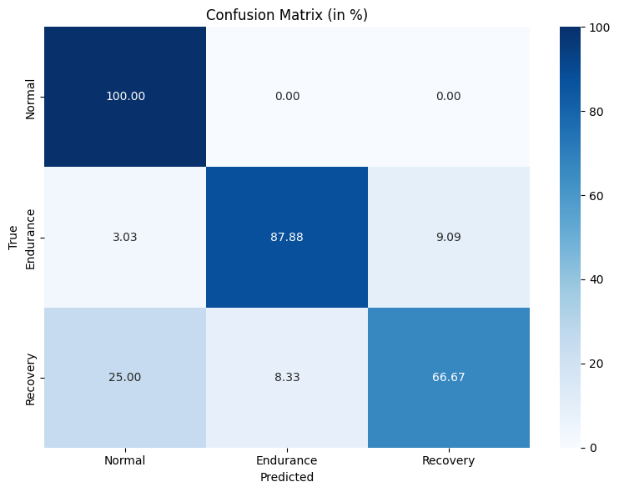
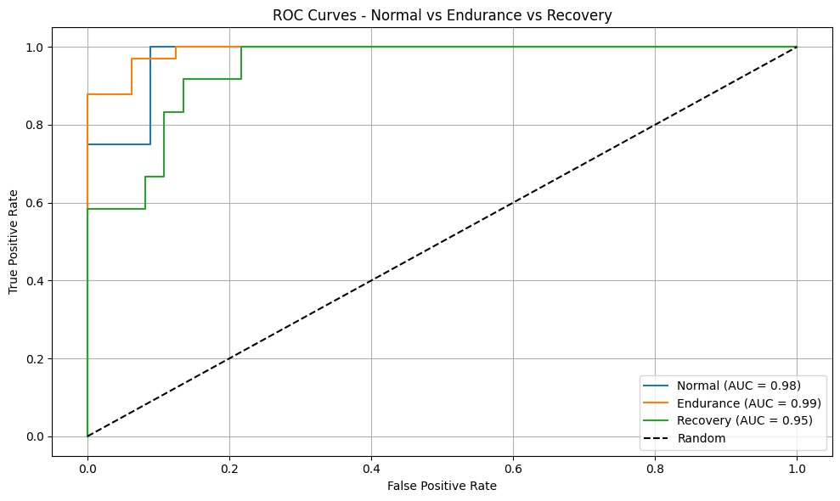
RESULTS
Optimizer Used – ADAM
Activation Function Used – ReLu.
13

Slide 20
CONCLUSION
The Customized Model demonstrates superior performance over the CNN + LSTM, LSTM + Transformer, and CNN + Transformer models across almost all evaluation metrics. It provides better overall accuracy, higher AUC scores, and more balanced classification across Endurance, Normal, and Recovery breathing patterns. This makes it the most reliable and robust choice for multi-class breathing pattern classification.
Metric | Class E (Endurance) | Class N (Normal) | Class R (Recovery)
Precision | 0.91 | 0.69 | 0.67
Recall | 0.70 | 0.87 | 0.65
F1 Score | 0.79 | 0.77 | 0.66
Accuracy | 0.87 | 0.82 | 0.77
AUC | 0.98 | 0.99 | 0.95
14

Slide 21
Feature | Simple Model | Complex Model (Your Framework)
Temporal pattern detection | Poor | Excellent (LSTM + Transformer)
Spatial feature extraction | Minimal | Strong (CNN layers)
Interpretability via attention | None | Present (Custom Attention Layer)
Accuracy & generalization | Low to Moderate | High
Suitability for real-time edge AI | Moderate | Achievable with model optimization
15

Slide 22
1. Temporal and Sequential Data Modeling
Reason: Breathing signals are time-dependent and contain long-range dependencies (e.g., apnea episodes).
Why complex model?
LSTM and Transformers are capable of capturing temporal dynamics much better than traditional models.
2. Multi-Modal Feature Extraction
Reason: The input includes varied sensor data (pressure, temperature, humidity, etc.), which may have spatial and temporal correlations.
Why complex model?
CNN layers effectively extract spatial patterns and local features from raw signal inputs.
3.Attention Mechanisms for Interpretability
Reason: Identifying critical segments in the breathing cycle (e.g., shallow breathing or irregular spikes).
Why complex model?
Custom Attention Layer helps focus on key time windows and improves interpretability for medical validation.
4.Performance and Generalization
Reason: Simple models may underfit complex physiological signals.
Why complex model?
Deep models with stacked layers improve non-linear representation and achieve higher accuracy and robustness.
16

Slide 23
5. Scalability to More Conditions
Reason: You may want to detect more than just breathing rate – such as apnea, hyperventilation, irregularity, etc.
Why complex model?
The architecture is scalable and can learn patterns for multi-label classification or anomaly detection.
6.Real-time Inference on Edge Devices
Reason: Despite complexity, the model can be optimized and pruned for deployment on embedded systems.
Why complex model?
Transformer + CNN-based models can be quantized or compressed using tools like TensorRT or TensorFlow Lite.
17

